Slide 1
PillForU

Slide 2
Is it easy for everyone?
Is it easy for your grandmother? Grandfather? Parents?

Slide 3
01
It’s time
Server has all the information what where and when you should take pills
02
Notification
When time for dosage came it notifies pupil that he should go to device
03
Dosage
It gives you right ammount of pills you dont have to remember about it
04
Feedback
As a caretaker you will be notified with informations when your pupil took medicin or if he hasn’t taken any

Slide 4
How does it work?
Can you see this three circles? Each of them is one box with pills. When there is information you should take a pill you just simply go to device click buton on it and it drops enought pills from each box.
Polopiryna x1
Vitamin C x2
Vitamin B x2

Slide 5
Flexibility
1.There is no limitation what kind of drugs can be in device.
2. There is no limitation how many users can use it at once. This is why it can help health care of out country in hospitals and nursing homes

Slide 6
Safe dosage
Your doctor can be your caretaker
He will have all information of your treatment and he can adjust it to your needs.

Slide 7
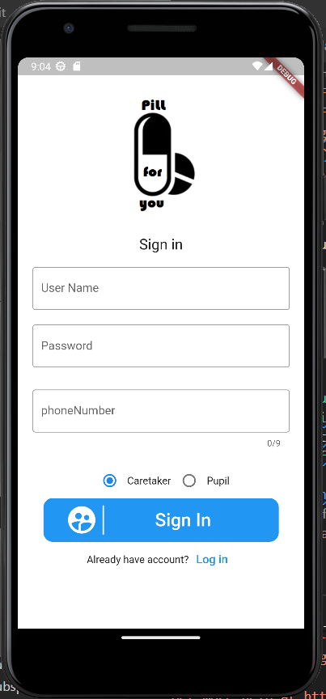
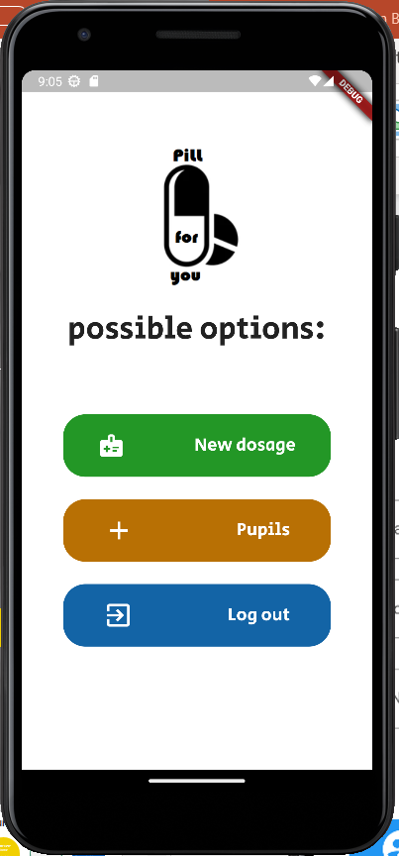
0
Design

Slide 8
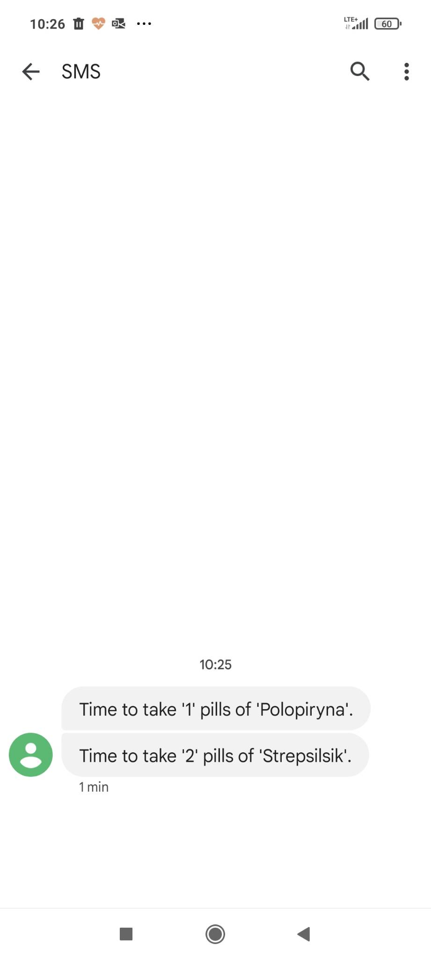
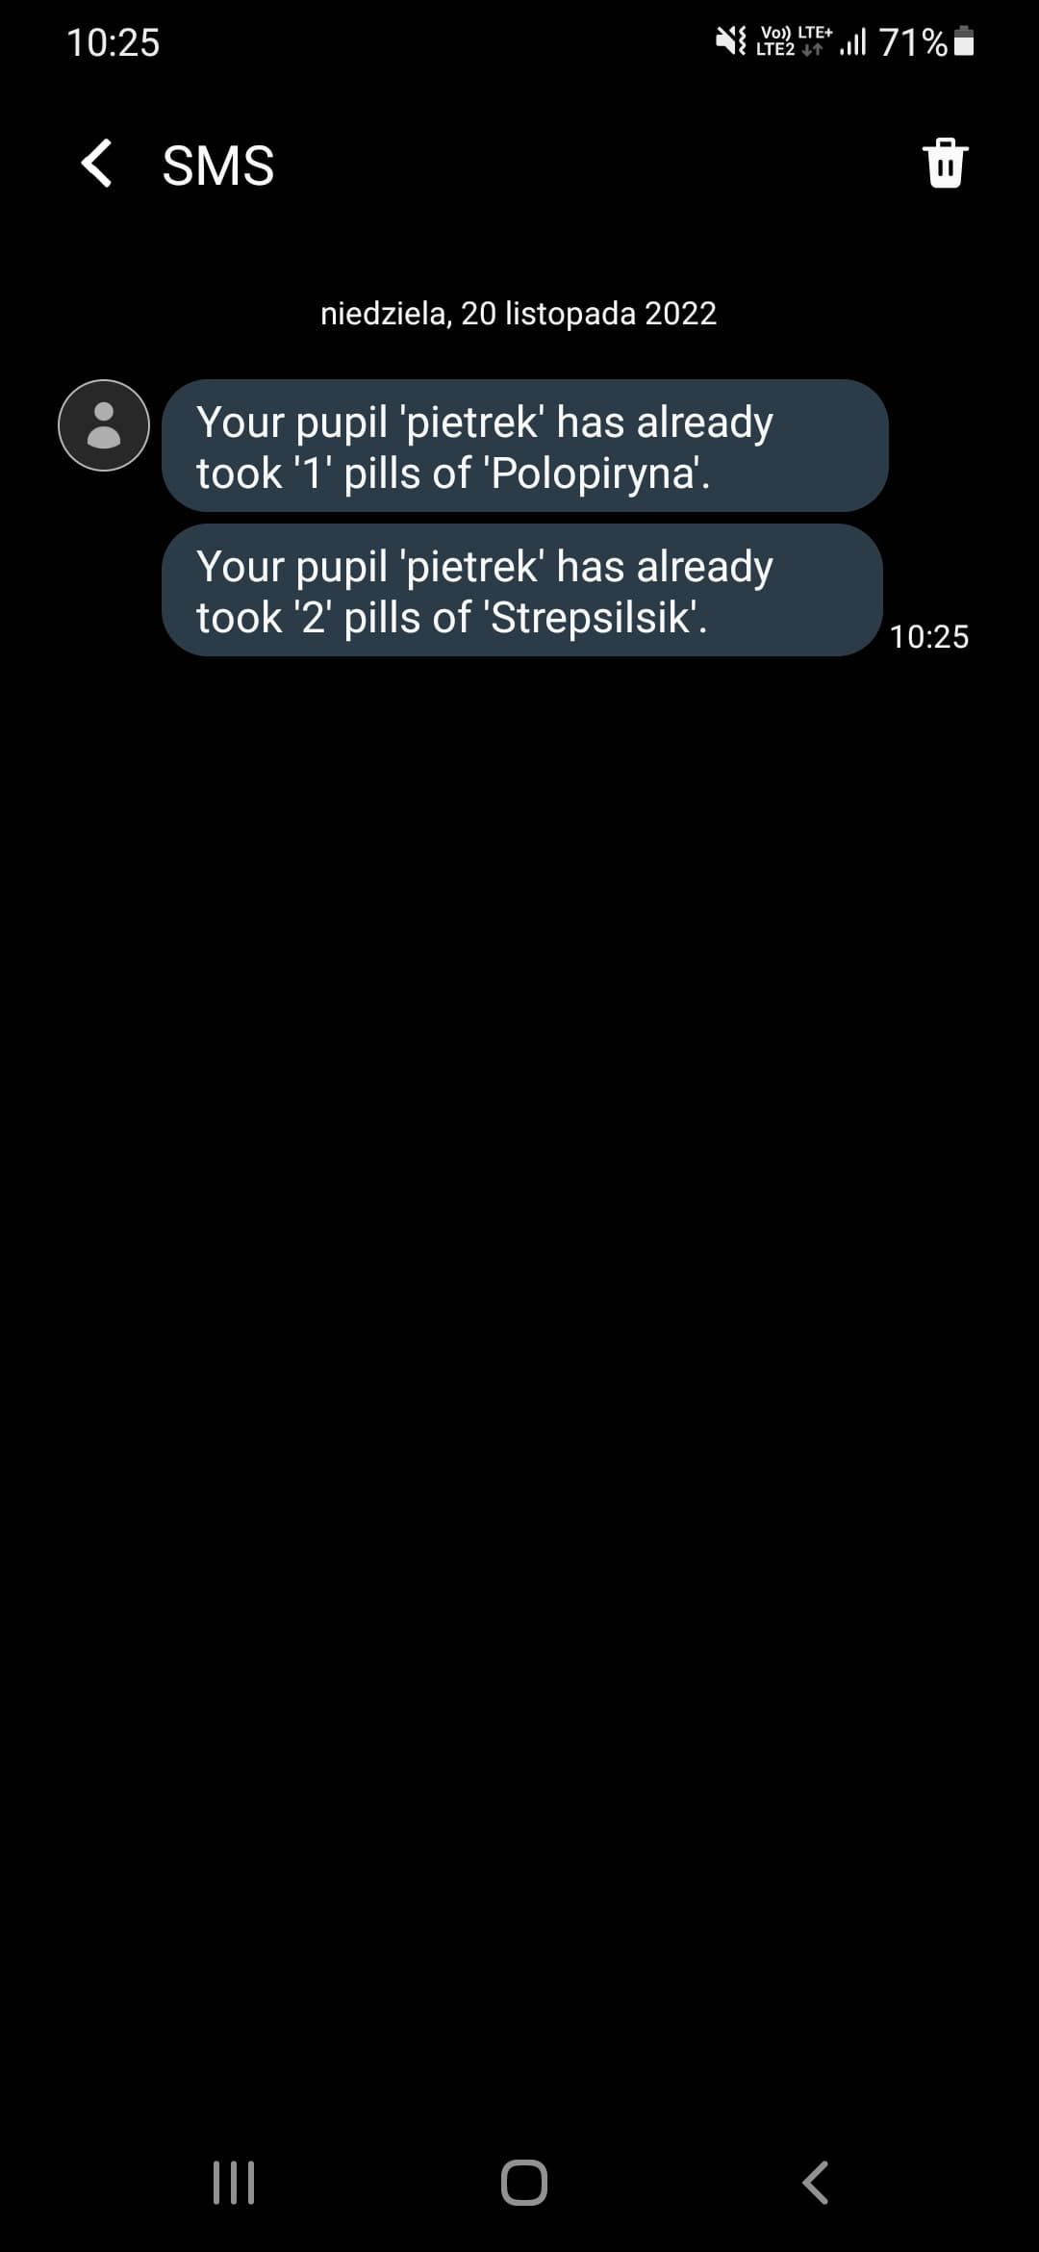
0
Caretaker
Pupil

Slide 9
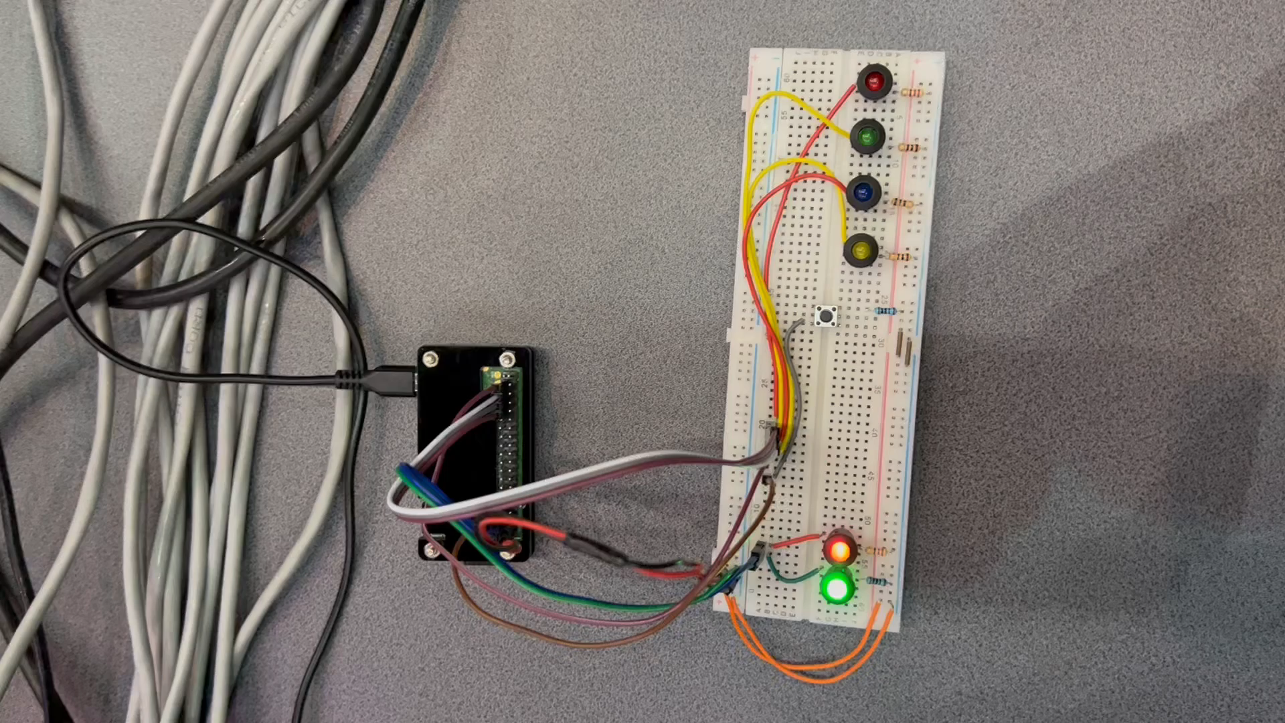
Demonstration

Slide 10
TheFlowers:
Piotr Targowski
Bartłomiej Szykuła
Filip Szpręgiel
Jakub Walczak
Maciej Janowski

